Slide 1


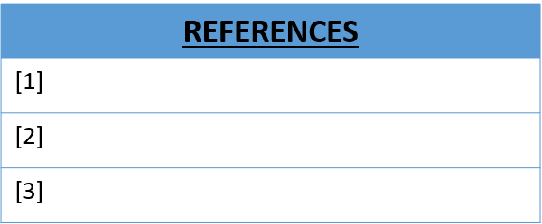
BLDE Association’s Vachana Pitamaha, Dr. P. G. H. College of Engineering, Vijayapur-586103, Karnataka, India
DEPARTMENT OF COMPUTER SCIENCE AND ENGINEERING
“ELECTRICITY BILLING SYSTEM”
Soumya Rangapur (2BL22CS177),Soumya Arakeri(2BL22CS178),Soumya Patil(2BL22CS179),Sachidananda Bevinamarad
OBJECTIVES:
1.This project aims at serving the department of electricity by computerizing the billing system.
2.It mainly focuses on the calculation of units consumed during the specified time and the money to be charged by the electricity offices.
Flow Diagram
RESULTS
CONCLUSION

